Slide 1

Capstone Project
Play Store App Review Analysis
Shivam Kumar

Slide 2
Overview of Our Project
As we all know, the Google Play Store is the most widely used app store for Android devices, with millions of apps available for download. Our project focused on the following research questions:
What are the most popular categories of apps on the Google Play Store?
What is the relationship between app ratings and popularity on the Google Play Store?
Do price of the app effects the rating
To answer these questions We have to used statistical analysis techniques to analyze the data and identify patterns and trends.
Our analysis revealed that the most popular categories of apps on the Google Play Store are games, followed by tools and entertainment. We also found that popular apps tend to have high ratings, a large number of downloads, and a high number of user reviews. Furthermore, we found that there is a positive correlation between app ratings and popularity.
We also investigated the characteristics of popular apps on the Google Play Store. We found that popular apps tend to have a simple and intuitive user interface, high-quality graphics, and frequent updates. Additionally, we found that popular apps often have a large number of features and functionalities.
In conclusion, our project provides valuable insights into the factors that influence the popularity of mobile applications on the Google Play Store. Our findings can be useful for developers and marketers who are looking to create and promote successful apps on the platform. Thank you for your attention, and we welcome any questions you may have.

Slide 3
Content :
Abstract
Introduction
Problem Statement
Play Store Dataset
Steps Involved
Data Analysis
Conclusion

Slide 4
Abstract :
Google Play Store and formerly Android Market, developed by Google. It serves as the official app store for certified devices running on the Android operating system, It is allowing users to browse and download applications developed with the Android software development kit (SDK) and published through Google.
Google Play also serves as a digital media store, offering music, books, movies, and television programs.
Google Play featured more than 3.5 million Android applications. Android Market was announced by Google on August 28, 2008, and was made available to users on October 22.

Slide 5
Introduction
In today's era the Google Play Store is the largest and most popular android app store.
It is flooded with millions of application and it provides wide collection of data on features like rating, price, no of downloads & app descriptions .
Many app are being developed as apps are easy to create and its lucrative.
But it is important for developers to know which apps are loved by customers and
trending in market so that he develop only those apps and also there is high
completion between app providers producing similar application .
Analyzing customer needs is one of the bizarre takes in the business world today.
Hence proposing analyze data to developer that what customer is likely to download which category got the maximum download this all plays crucial role in app development.
Generally, customers downloads apps depending on number of downloads , positive reviews ,negative reviews, rating and comments.
In this project we have to above scenarios and help developers to which kind of app people really like.

Slide 6
Problem Statement:
The Play Store apps data has enormous potential to drive app-making businesses to success. Actionable insights can be drawn for developers to work on and capture the Android market.
Each app (row) has values for category, rating, size, and more. Another dataset contains customer reviews of the android apps.
Explore and analyze the data to discover key factors responsible for app engagement and success.

Slide 7
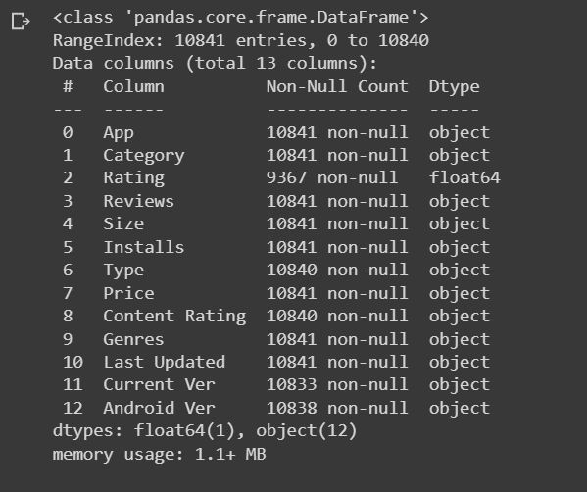
Introduction of Dataset :
There are two datasets
Play Store Data : This dataset has 10841 observations in it with 13 columns and it is a mix between categorical and numeric values.
User Reviews : This dataset has 64294 observations in it with 5 columns and it is a mix between categorical and numeric values.

Slide 8
Steps took to Analyse play store App review :
Importing the necessary Libraries
Mounting Google Drive and Creating a file path
Importing Dataset From Drive
Printing the information about a DataFrame including the index dtype and columns, non-null values and memory usage.
We are going to use Pandas describe() view some basic statistical details like percentile, mean, std etc.
Checking the sum of null values present in our dataset
Data cleaning and handling null values
Dealing with duplicate values in both datasets
Taking necessary columns only
Merging two dataframes
Data visualization

Slide 9
Analysis:
Play Store App Analysis:
What is percentage of Review Sentiments
Which category of Apps from the Content Rating column are found more on playstore
Analyse what portion of the apps in play store are paid and free
Top app category in play store(Count of apps in each category)
App installed according to category(Number of installed application for each category)
Top app genres in play store(Count of apps in each genres)
App installed according to genres(Number of installed applications for each genres)
Percentage of free vs paid apps in play store
Content rating
Analyse the distributions of app rating, app size and app price
Top earning app in play store
Average installation of app across the year
What are the top five installed apps in any category
How many apps are present in each category according to their version(Free/paid)?
Rating Vs Type
Which category App's have most number of installs?

Slide 10
App Review Analysis:
Distribution of Sentiment Subjectivity
Percentage of Review Sentiments
Distribution of Sentiment Polarity
Polarity Vs Subjectivity

Slide 11
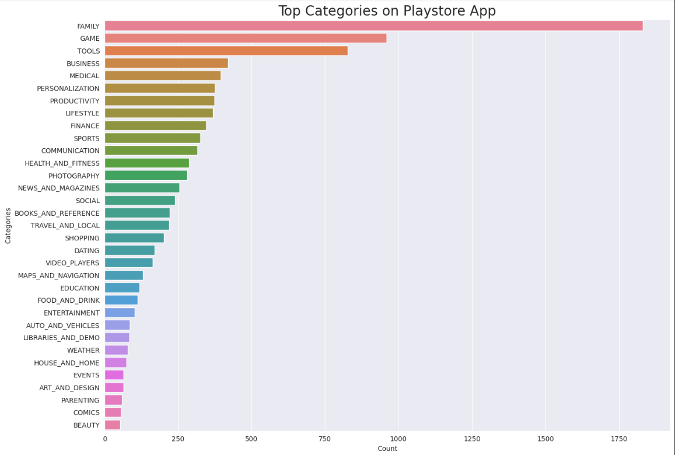
Average reviews across each category
In the given plot we can say that maximum average reviews high is for Family , Game & Tools category Apps.
And minimum average reviews for Beauty , Comics & Parenting category apps.

Slide 12
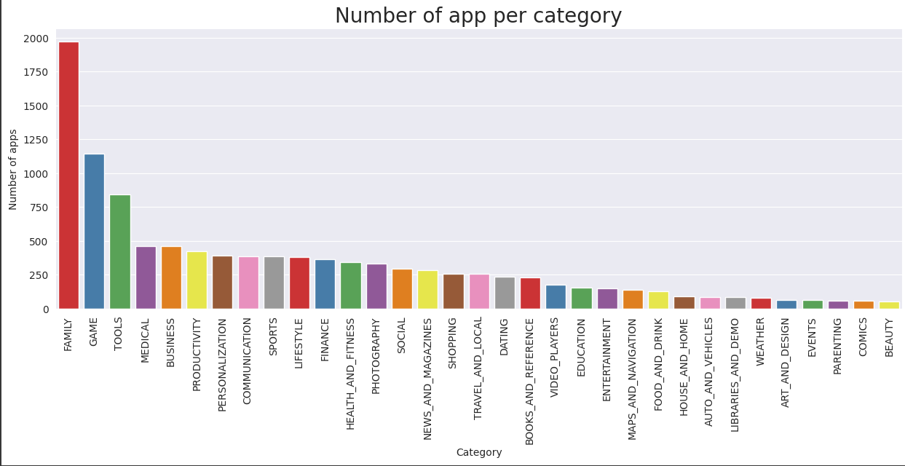
Top app category in play store(Count of apps in each category)
As we can see the plot maximum no. of apps present in the play store are comes under Family, Games and Tools Category.
And minimum no. of apps are present in Comics,Parenting,Beauty category.

Slide 13
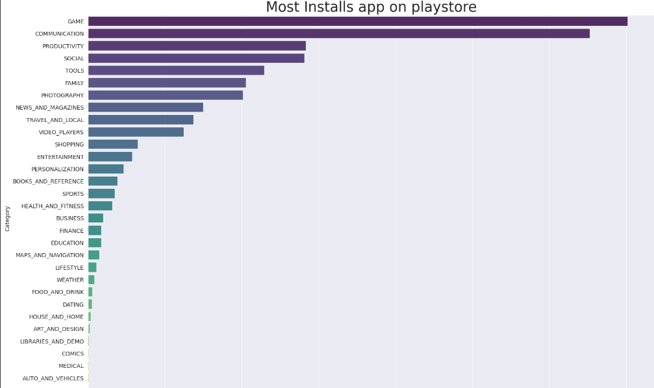
App installed according to category(Number of Installed applications for each category)
As we can see from the above plot: Maximum number of apps present in google play store comes under Family, Games and Tools Category.
But as per the installation and requirement in the market plot, scenario is not the same. Maximum installed apps comes under Games,Communication and Social Category.

Slide 14
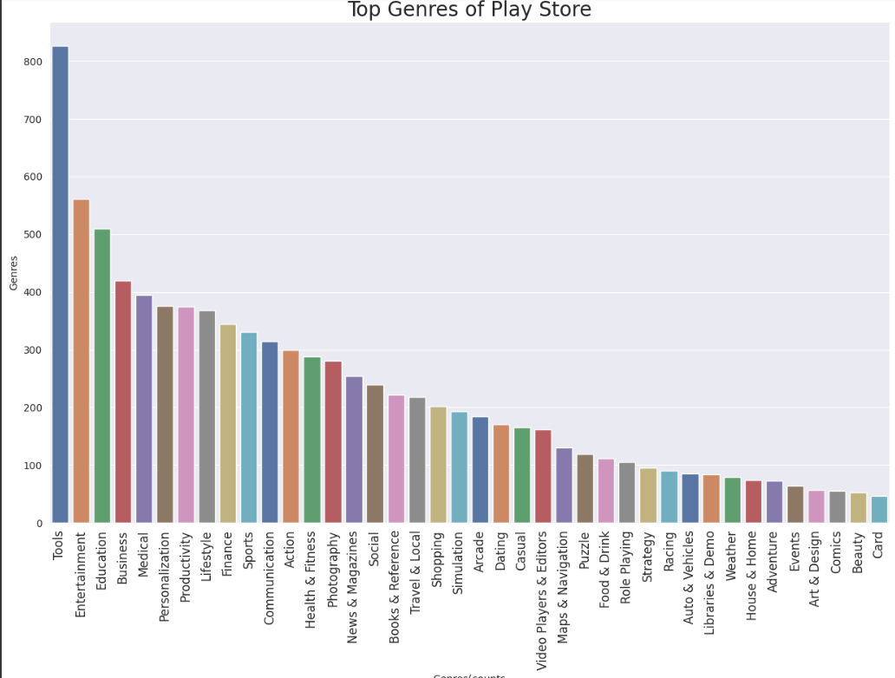
Top app genres in play store(Count of apps in each genres)
As we can see the plot maximum no. of apps present in the play store are comes under Tools, Entertainment and Education Genres..
Our chart shows lowest genres apps are comics , beauty & card.

Slide 15
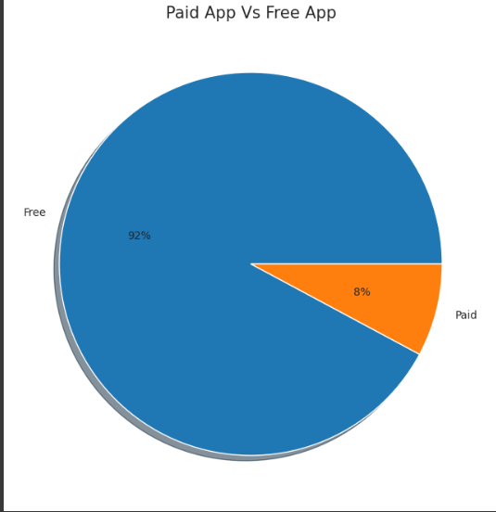
Percentage of free vs paid apps in play store
As we can see pie chart maximum no. of apps are free version in the given dataset.
This information will help business to decide whether they should keep the app free to install and generate revenue from ads and other subscriptions or it should be a paid app.

Slide 16
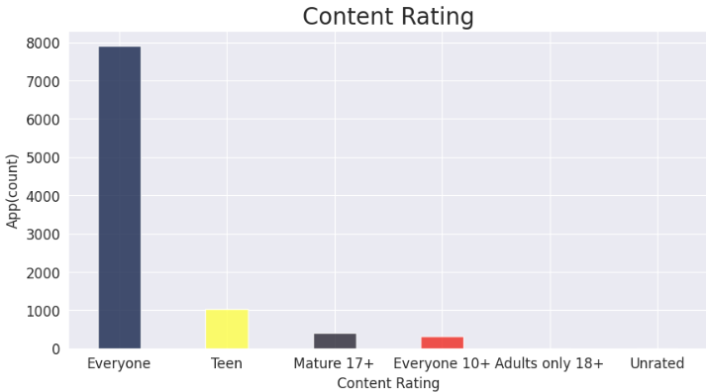
Content Rating
As we can see the plot maximum no. of apps are in google play store comes under Everyone,Teen,Mature 17+ content rating.
There is very few apps comes under Adults only 18+,Unrated content rating.

Slide 17
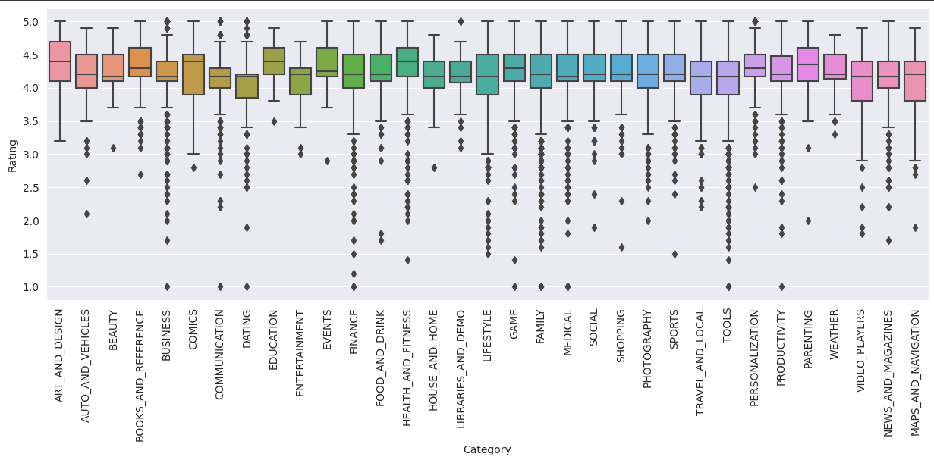
Distribution of App Rating
As we can see the Chart maximum no. of apps installed which has rating lies between 4.0 to 4.5
Very few apps are installed which has rating below 3.0

Slide 18
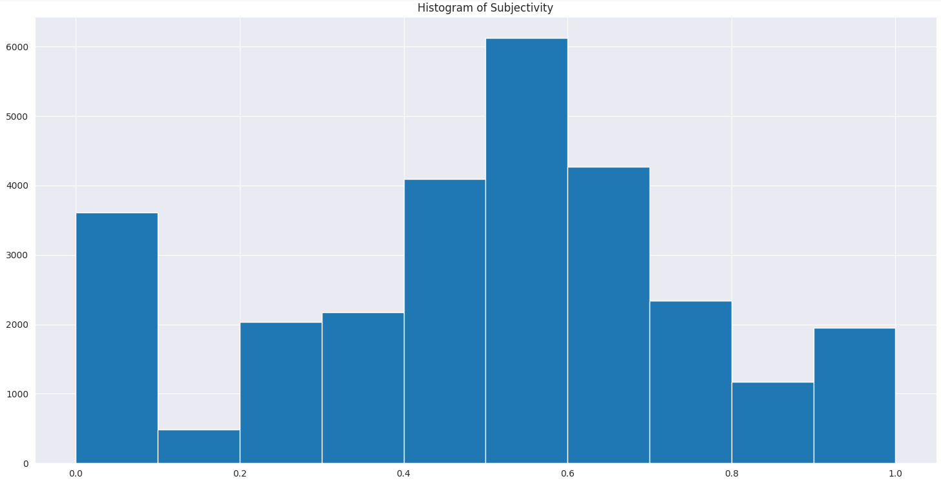
Distribution of Sentiment Subjectivity
Sentiment Subjectivity generally refer to personal opinion, emotion or judgment, which lies in the range of [0,1].
As we see the histogram plot It can be seen that maximum number of sentiment subjectivity lies between 0.4 to 0.7.
From this we can conclude that maximum number of users give reviews to the applications, according to their experience.

Slide 19
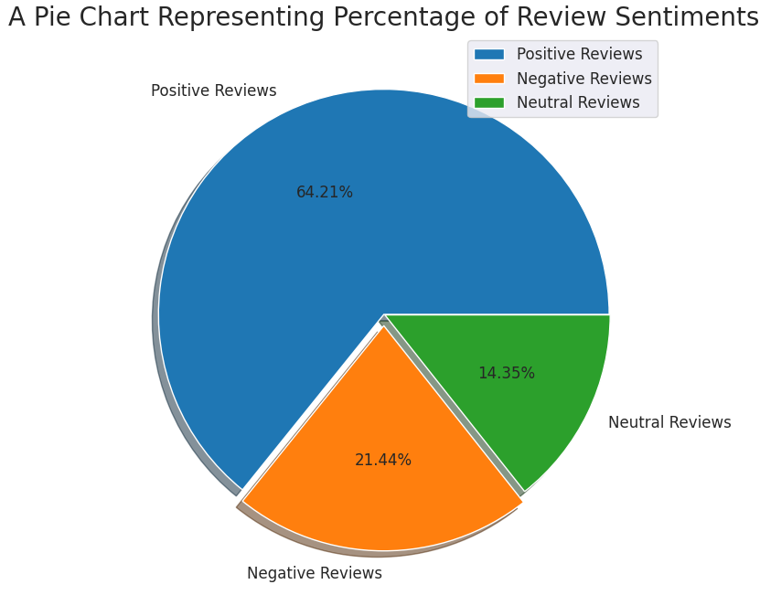
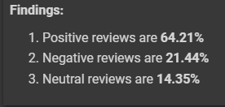
Percentage of Review Sentiments
We can say that most of the users are happy with the quality and Content of the Apps, considering the fact there are 64.21% review are positive.

Slide 20
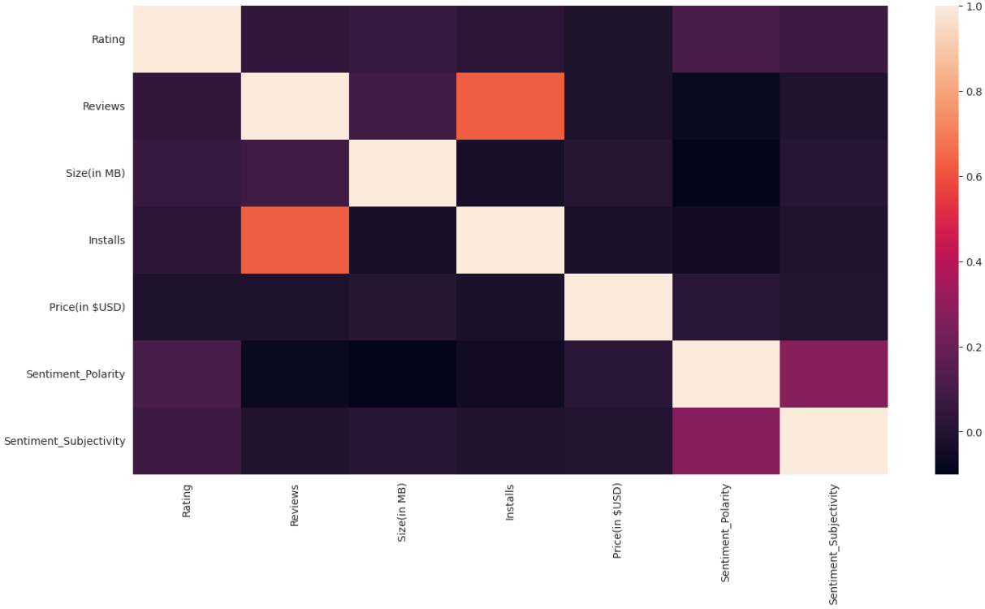
Correlation
Correlation is a statistical measure that indicates the extent to which two or more variables fluctuate together.
In simple terms, it tells us how much does one variable changes for a slight change in another variable. It may take positive, negative and zero values depending on the direction of the change.

Slide 21
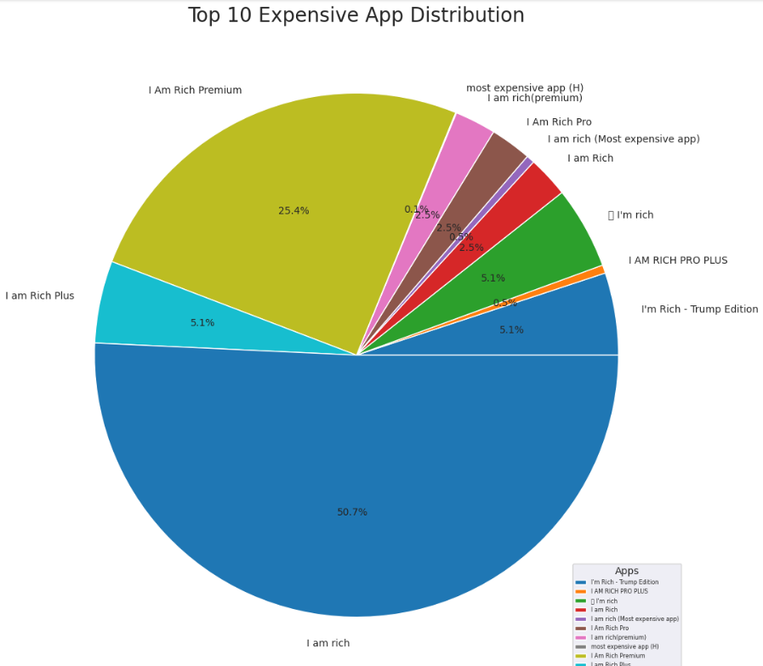
Top 10 Expensive Apps
From the graph we can interpret that the I am Rich app is the most expensive app in the play store. But this seems to be like a junk app. We need to further analyze if it is a junk app or not by deploying machine learning models in it.

Slide 22
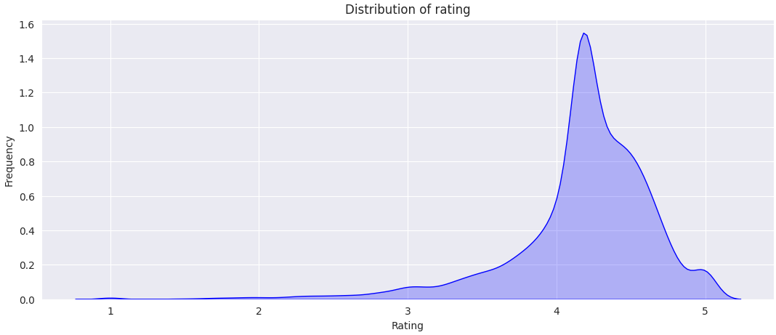
Distribution of the ratings of the apps
From the graph we can come to a conclusion that most of the apps in google play store are rated in between 3.5 to 4.8

Slide 23
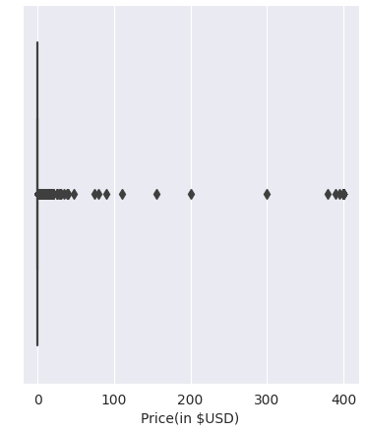
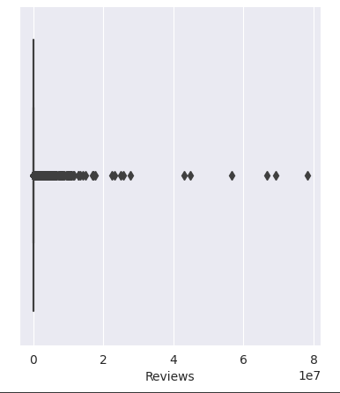
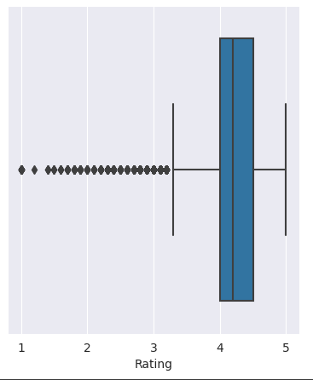
Finding Co-Relate between Rating , Review & Price columns
1. We can see that most of the Ratings are between 4 and around 4.5 and 5
2. As far as review are connected , for most of the Apps Review are not given.
3. Also Price most of the Apps are free.

Slide 24
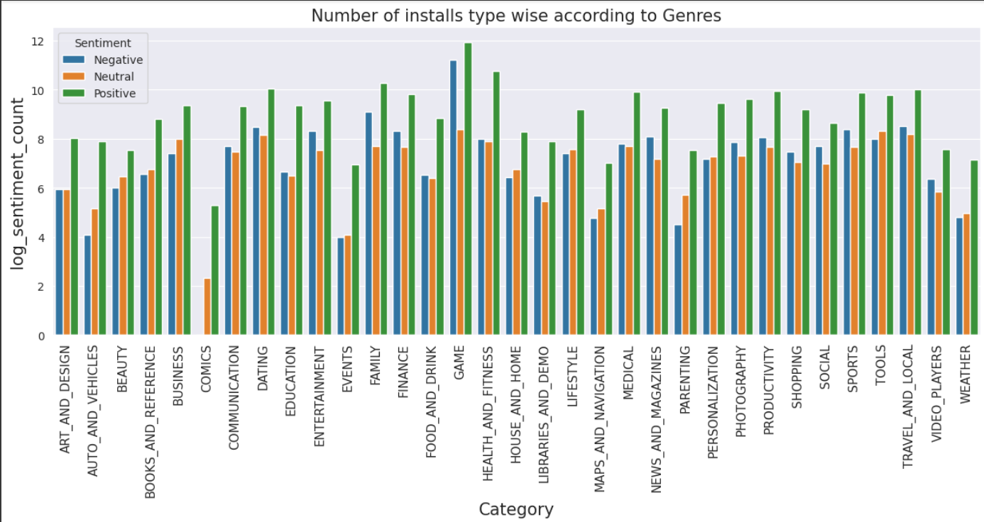
Distribution of type of reviews in the dataset
Majority of the genres have high positive sentiments, when compared to neutral and negative ones.

Slide 25
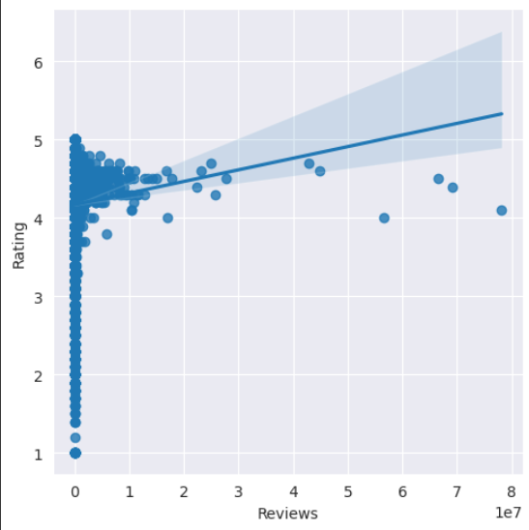
Relationship between Ratings vs Reviews
From the above plot, we cannot say that there is a relation, it seems that irrespective of the Reviews, the ratings are majorly between 4 and 5, which we also noticed before.
Also it is not correct to assume that rating and reviews have a relationship because reviews can be positive or negative and increase in the number of reviews does not show whether. the Reviews are Positive or Negative

Slide 26
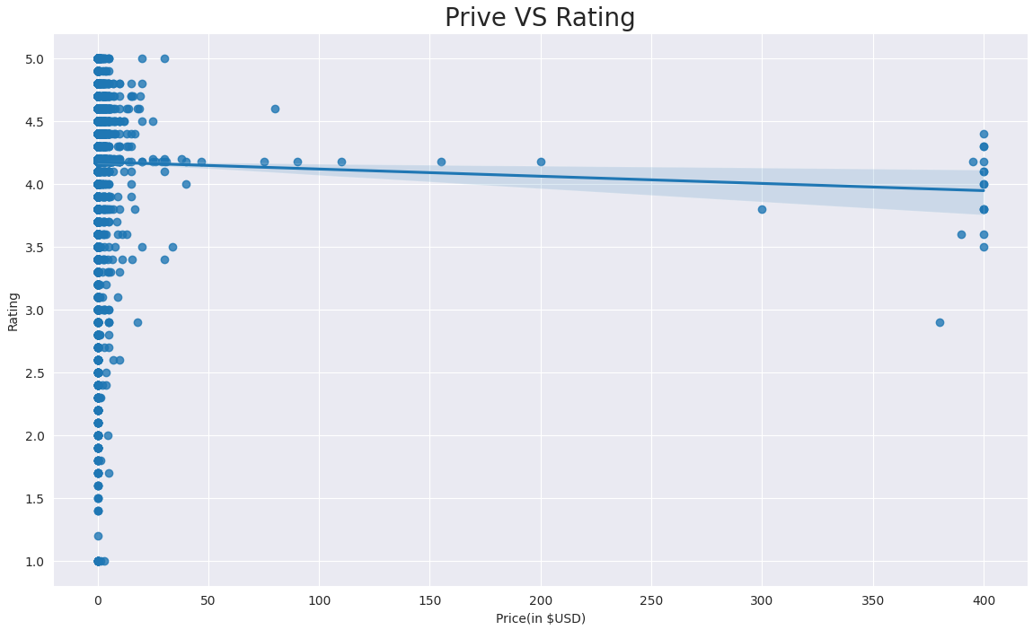
Do price of the app effects the rating
The findings reveal that there are strong correlations between customer rating and popularity (rank of app downloads).
We found evidence for a mild correlation between app price and the number of features claimed for the app and also found that higher priced features tended to be lower rated by their users.

Slide 27
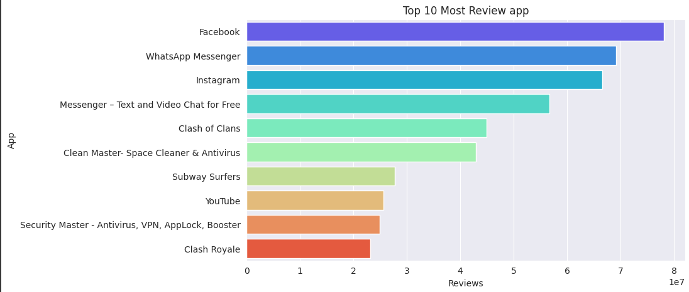
10 most reviewed App on Play Store app?
One important insight that we can see from this chart that there are 3 Apps in the top 10 which are targeted towards Teens as their audience.
From Chart we can see that there are total 1036 apps targeted towards Teens as audience, which is much lesser in number if we see "Everyone" category having 7903 Apps, yet 3 of them featured in top 10 reviewed apps.
This means there is a lot of potential to grow the business if we can appropriately target Teens as our audience.

Slide 28
Conclusion:
We calculated the average reviews across each category and we also calculated top category and top genres of apps in the given dataset.
Further we also calculated apps installed according to their category and genres. We observe the maximum number of apps present in google play store comes under Tools, Entertainment and Education Genres but as per the installation and requirement in the market plot, scenario is not the same. Maximum installed apps come under Communication,Productivity and Social Genres.
We also observe that the percentage of free apps is more than 90% in the given dataset.
We also draw the pie chart of review sentiments and observe that the percentage of positive sentiments is near about 64%.
Histogram of sentiment subjectivity and observe the maximum number of sentiment subjectivity lies between 0.4 to
0.7. From this we can conclude that the maximum number of users give reviews to the applications, according to their experience.

Slide 29


